Slide 1
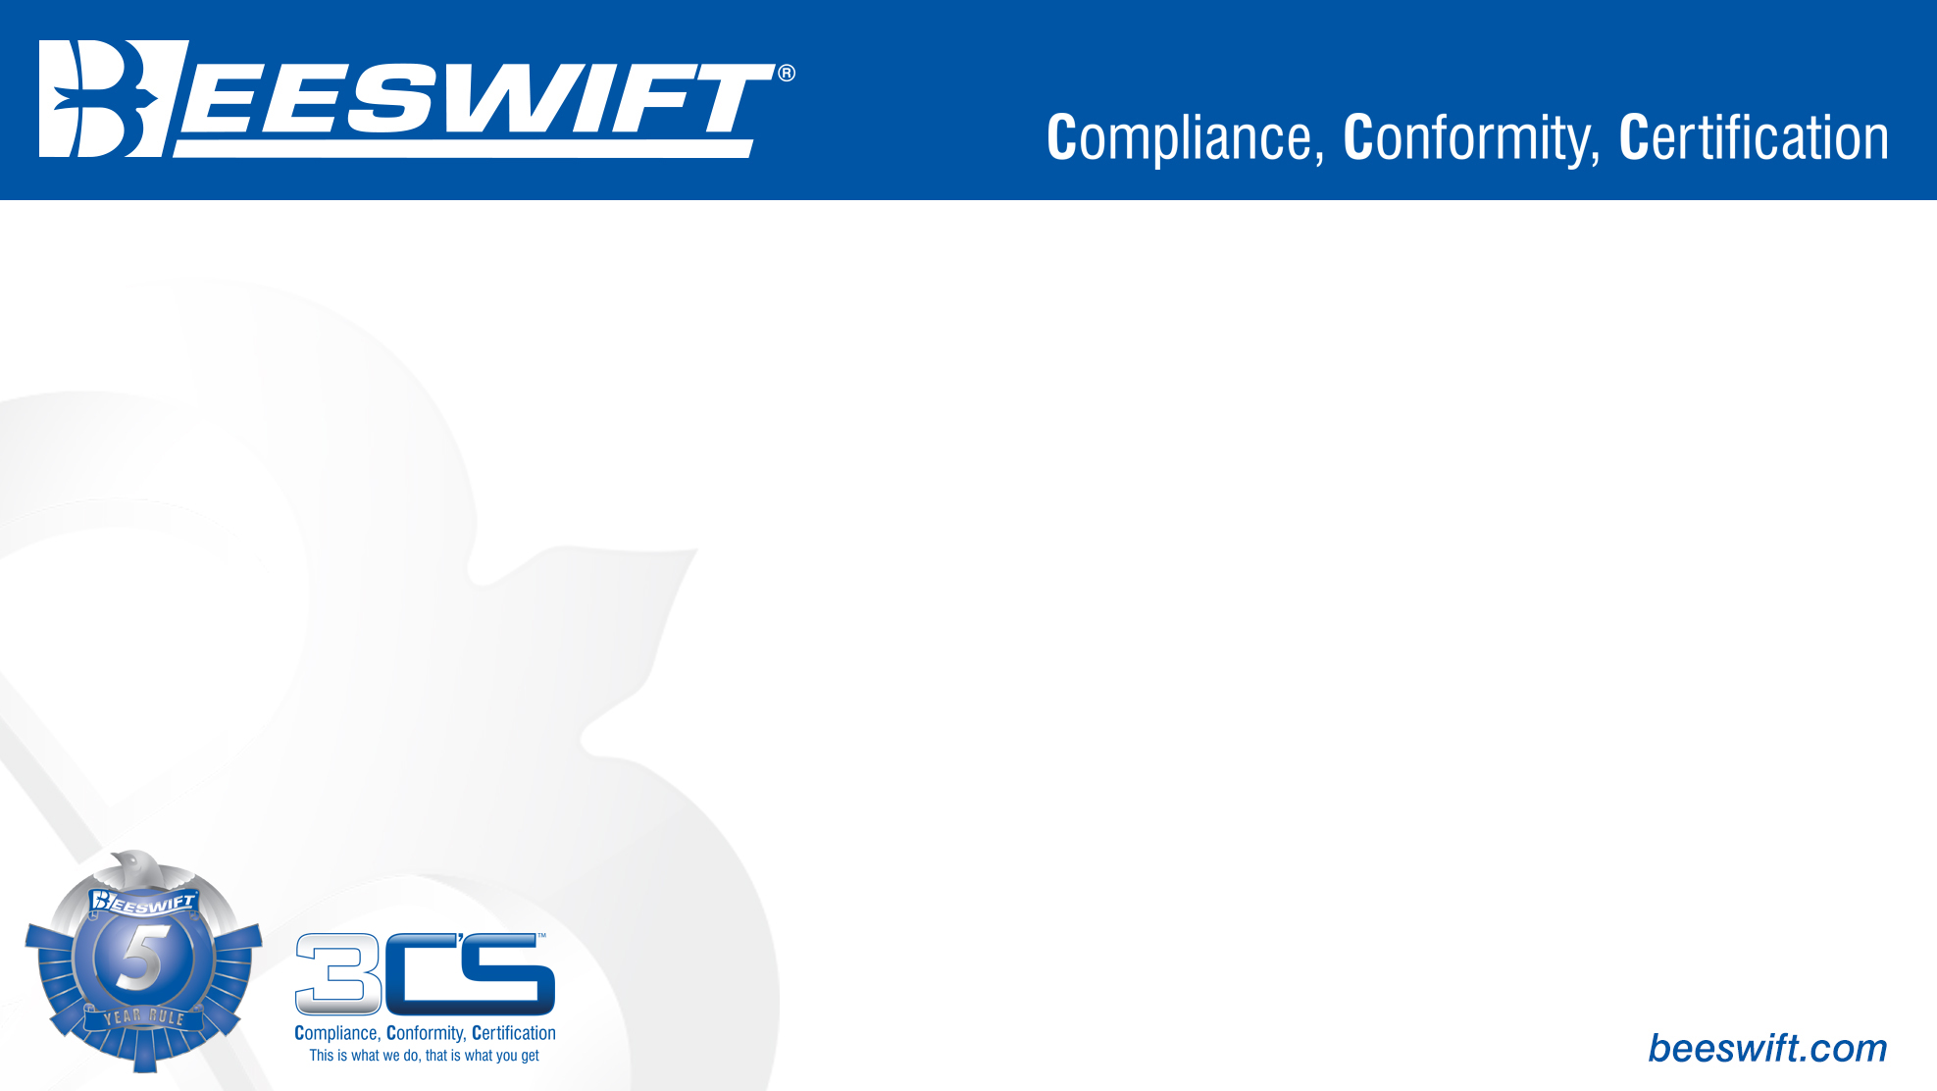
Fire Retardant & Anti Static
(EN ISO 11611, EN ISO 11612, EN 1149)

Slide 2

EN ISO 11611 – Protective clothing for use in welding and allied processes
Protective clothing certified according to EN ISO 11611 gives the wearer protection against small splashes of molten metal, and brief contact with flame. The garments certified to this standard are suitable for use in welding and allied processes.
The garment is classified for the protection ability against different levels of welding technology, which cause more or less spatter and radiant heat.
Class 1 - Protects against less hazardous welding techniques and situations, causing lower spatter and radiant heat.
Class 2 - Protects against riskier welding techniques and situations, which causes higher levels of spatter and radiant heat.
(A1) Limited Flame Spread.
(A2) Limited Flame Spread, hemmed specimens.

Slide 3
EN ISO 11612 – Clothing to protect against heat and flame.
The requirements apply to clothing intended for a wide range of application which offer limited flame spread and provide protection against various hazards including Radiant Heat, Convective Heat and splatters of Molten Metal. The pictogram is the same as the withdrawn EN531 standard. There are several fabric tests within this EN Standard and the results of the tests are represented by the pre-fix letters A, B, C, D, E and F.
A number after these letters indicates the performance of the fabric within this test. If a (0) is shown, then the fabric has not been tested or does not achieve the lowest value attainable with the test.
General Requirement: The mechanical strength and heat resistance at a temperature of 180°C: the material shall not ignite or melt and shall not shrink by more than 5%.
This is an example of the pictogram. All letters associated with the tests it passes are listed down the side.

Slide 4
EN ISO 11612 – Clothing to protect against heat and flame.
Letter A
This test consists of applying a flame to a fabric sample for 10 seconds. To pass the test, the after flame & smoulder times and formation of holes must be within the tolerances within the standard. The application of a flame can take place in two ways:
Procedure A (leads to Class A1), the flame is applied horizontally (similarly to EN470 and EN531)
Procedure B (leads to Class A2), the flame is applied laterally.
No specimen shall permit any part of the lowest boundary of any flame to reach the upper or either vertical edges.
No specimen shall give hole formation of 5mm or greater in any direction, except for an inter-lining that is used for specific protection other than heat and flame protection.
No specimen shall give flaming or molten debris.
The mean value of after flame time shall be ≤ 2s.
The mean value of afterglow time shall be ≤ 2s.
No specimen shall permit any part of the lowest boundary of any flame to reach the upper or either vertical edges.
No specimen shall give flaming or molten debris.
The mean value of after flame time shall be ≤ 2s.
The mean value of afterglow time shall be ≤ 2s.

Slide 5
EN ISO 11612 – Clothing to protect against heat and flame.
Letter B
Convective Heat: determination of the heat transmission when exposed to flames. The sample is held above the flame and the rise in temperature on the topside of the sample is measured with a calorimeter. The length of time the sample can remain exposed before its temperature rises by 24 °C is determined.
B1: 4 < 10 seconds
B2: 10 < 20 seconds
B3: 21 seconds and longer
Letter C
Exposure to Radiant Heat. In this test, a fabric sample is exposed to radiant heat (infrared rays). The temperature on the reverse (unexposed) side of the sample is registered using a calorimeter. Subsequently, the length of time the sample the sample can remain exposed before its temperature rises by 24°C is measured. The test procedure is the same as ISO 11611, but the classification is different:
C1: 7 < 20 seconds
C2: 20 < 50 seconds
C3: 50 < 95 seconds
C4: 95 seconds and longer

Slide 6
EN ISO 11612 – Clothing to protect against heat and flame.
Letter D & E
D = Aluminium
E = Molten Iron
Determining the level of protection against spatters of molten metal. A membrane (with similar properties to human skin) is attached to the reverse of the fabric sample sequentially rising quantities of molten metal (Aluminium or Iron as applicable) are splashed on the sample. The quantity of molten metal which deforms the membrane is determined.
The classification for molten aluminium is:
The classification for molten iron is:
D1: 100 < 200 grams
D2: 200 <350 grams
D3: 350 grams and more
E1: 60 < 120 grams
E2: 120 < 200 grams
E3: 200 grams and more
Letter F
This is a test to establish a value for contact heat. The classification in this respect:
F1: 5 < 10 seconds
F2: 10 < 15 seconds
F3: 15 seconds and longer

Slide 7
EN 1149 – Protective clothing. Electrostatic properties.
:
European standard for protective clothing with antistatic characteristics. The clothing protects against sudden discharges of electrostatic energy and should be worn whenever there is a risk that static sparks may ignite inflammable substances such as gas and oil.
The article should cover all other materials that do not provide protection against static electricity. Thin attachments such as labels, reflectors and the like, must be attached permanently.
Conductive parts, such as buttons and zips, are permitted provided that they are covered completely by the protective material against discharges of electrostatic energy.
EN1149-1 measure of surface resistivity
EN1149-3 measure of charge decay

Slide 8
EN 1149 – Protective clothing. Electrostatic properties.
European standard for garments that protect against electrostatic charge where there is a risk of explosion e.g. in refineries.
An electrostatic dissipative material shall ensure that the distance between the conductive threads contained in the material must not be greater than 10mm.
The garments must permanently cover all material that does not provide electrostatic protection.
Thin additions, such as labels and reflectors, must be permanently sewn on. No loose-hanging parts are permitted.
Elements that conduct electricity (zips, buttons, etc) are permitted if they are completely covered by the electrostatic protective material.
When using these garments, the wearer must be properly earthed. The resistance between the wearer and the earth shall be less than 108Ω. This can be achieved by wearing suitable footwear. Antistatic footwear approved to EN ISO 20344 or EN 20345 must be used.

Slide 9
EN 1149 – Protective clothing. Electrostatic properties.
Electrostatic dissipative protective clothing shall not be opened or removed in flammable or explosive atmospheres or while handling flammable or explosive substances. Wear and tear, laundering and any contamination can affect the electrostatic dissipative performance of the electrostatic dissipative protective clothing. The garment shall permanently cover all non-compliant material during normal use. The garment should only be used in rooms with increased oxygen content following approval from the relevant safety engineer.
Do not make alterations to the garments. Minor embroidery or transfer is permitted on fabric certified to EN ISO 11612 and shall be permanently attached to the garment so that separation is avoided.

Slide 10
For further information please visit www.Beeswift.co.uk
Or contact a sales representative at sales@Beeswift.com
This presentation’s intellectual property and design where applicable belongs to:
BEESWIFT Ltd, Delta Point, Greets Green Road, West Bromwich, B70 9PL. UK.

