Slide 1
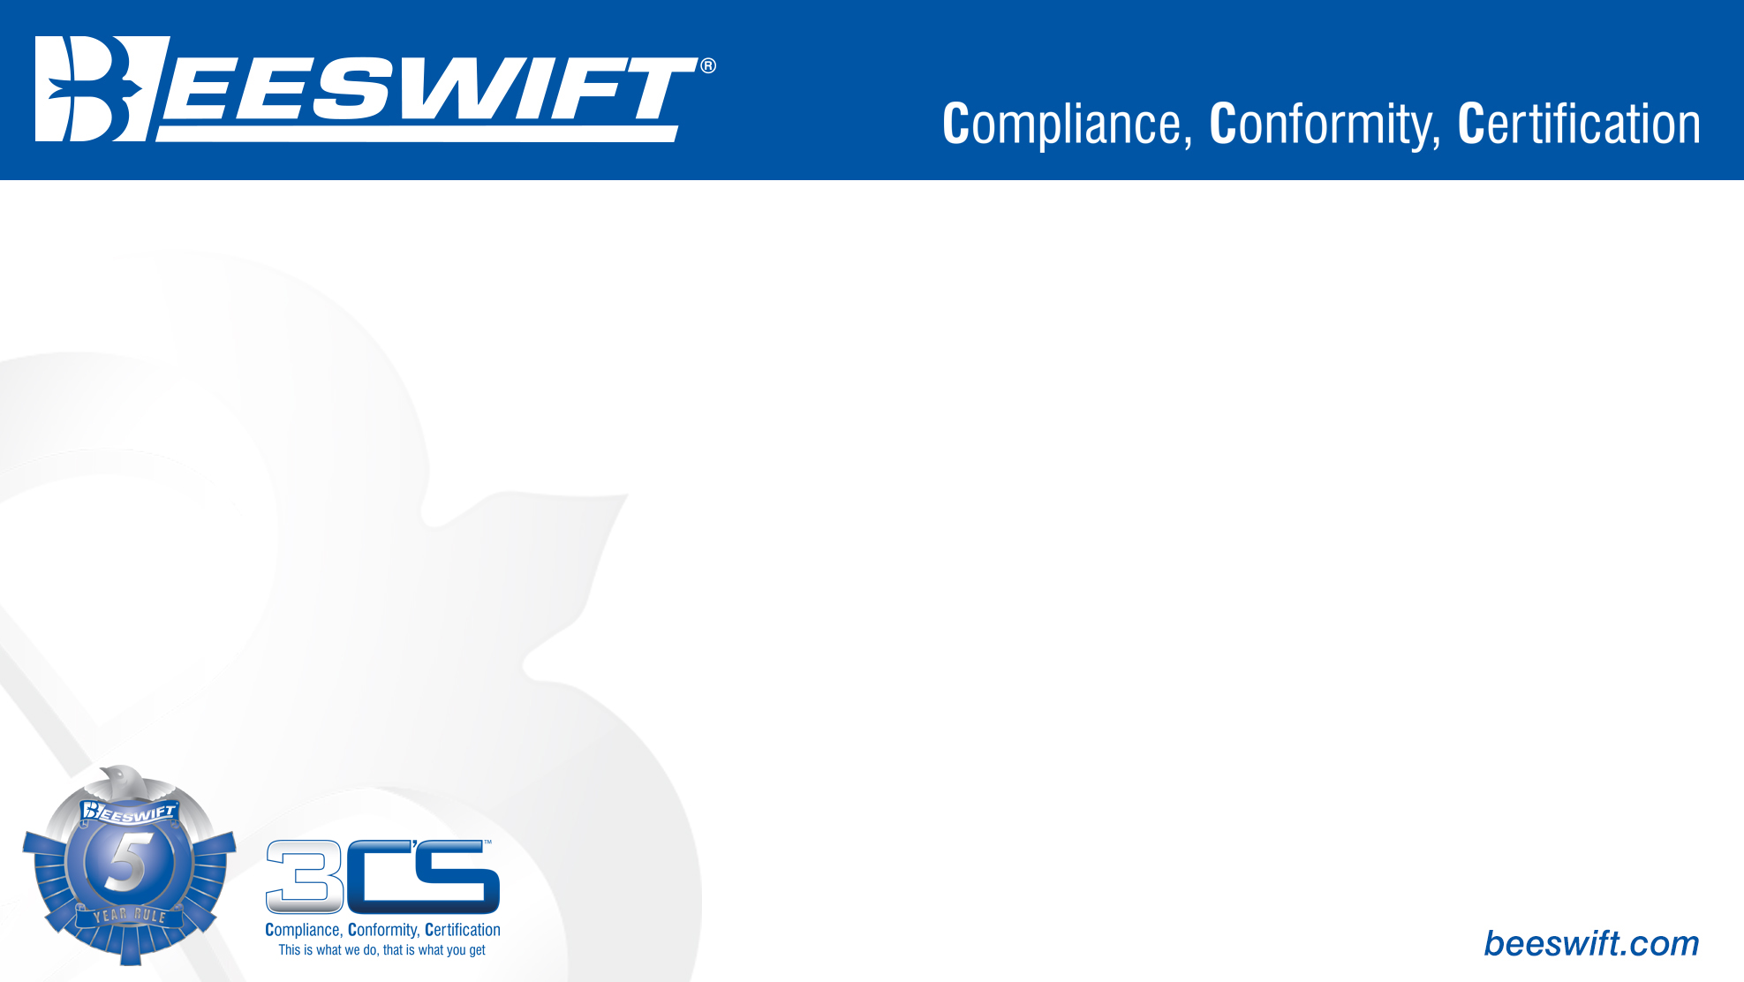
EN ISO 20345
Safety Footwear

Slide 2


EN ISO 20345 – Safety Footwear
Your foot is the foundation of your body. Like the foundation of a building, they need to be strong. You spend a lot of time on your feet and if you don’t wear the correct safety footwear and are caught in an accident you could do damage which could cause your life to change drastically.
According to HSE statistical analysis, 196,910 (29%) of accidents in 2016/2017 are caused by slips. Some of these could have been prevented with correct footwear. Getting the right footwear will make life safer and easier. Employers are legally responsible for providing the correct footwear.
The safety footwear standard is referred as EN ISO 20345. The EN ISO 20345 standard sets out minimum requirements that safety footwear must be successfully tested against.
The standard specifies all safety footwear must have toe protection. Basic safety footwear will have this as a minimum, but safety footwear can be tested for a lot of extra protective features. These are referred to as letter combinations which are explained in the next slide.

Slide 3
EN ISO 20345 – Safety Footwear
Rating | Letter Combinations | Description
NS | - | Non-Safety, Does not comply with EN ISO 20345.
SB | - | Safety toecap protecting against 200J impact.
SBP | P | As per SB, with penetration resistant midsole (P).
S1 | A FO E | As per SB, with Anti-static properties (A), Fuel oil resistant outsole (FO), Energy absorbing heel (E).
S1P | A FO E P | As per S1, with penetration resistant midsole (P).
S2 | A FO E WRU | As per S1, with Water resistant upper (WRU).
S3 | A FO E WRU P | As per S2, with penetration resistant midsole (P).
S4 | A FO E Waterproof | As per S1, with waterproof seal.
S5 | A FO E P Waterproof | As per S4, with penetration resistant midsole (P).

Slide 4
EN ISO 20345 – Safety Footwear
Other additional testing may give
C - Conductive
I - Electrical Insulating Footwear
HI - Insulation against heat
CL - Insulation against cold
M - Metatarsal Protection
AN - Ankle protection
CR - Cut resistant upper
HRO - Heat resistant outside compound: shall withstand 300 °C for 60s
WR - Water resistant footwear
In addition to the ratings shown above (S1, SB, S3 etc) all safety footwear must have a degree of slip resistance. The levels of slip resistance are:
Slip Resistance Rating | Explanation
SRA | Slip resistance on ceramic tile floor with dilute soap solution.
SRB | Slip resistance on steel floor with glycerol.
SRC | Slip resistance on ceramic tile floor with dilute soap solution and on steel floor with glycerol.

Slide 5
EN ISO 20345 – Safety Footwear
This slideshow is a simple breakdown of the marking and testing that footwear is/can be tested to.
More advanced explanations will be included on another presentation soon.

Slide 6
For further information please visit www.Beeswift.co.uk
Or contact a sales representative at sales@Beeswift.com
This presentation’s intellectual property and design where applicable belongs to:
BEESWIFT Ltd, Delta Point, Greets Green Road, West Bromwich, B70 9PL. UK.

